Slide 1
Lecture 6
Artificial neural networks
人工神经网络
应伟勤

Slide 2
Artificial neural networks
Introduction, or how the brain works
The neuron as a simple computing element
The perceptron
  Perceptron’s training algorithm
Multilayer neural networks
  The back-propagation training algorithm

Slide 3
A neural network can be defined as a model of reasoning based on the human brain. The brain consists of a densely interconnected set of nerve cells, or basic information-processing units, called neurons.
The human brain incorporates nearly 10 billion neurons and 60 trillion connections, synapses, between them. By using multiple neurons simultaneously, the brain can perform its functions much faster than the fastest computers in existence today.
Notes:
100亿
60万亿
突触

Slide 4
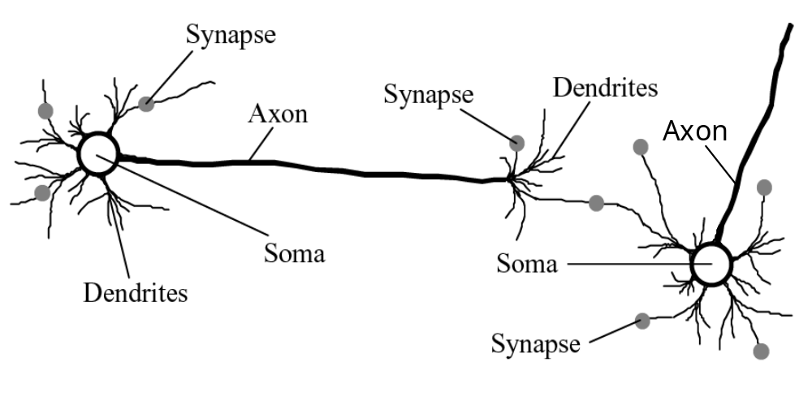
Biological neural network
Notes:
细胞体
轴突
突触

Slide 5
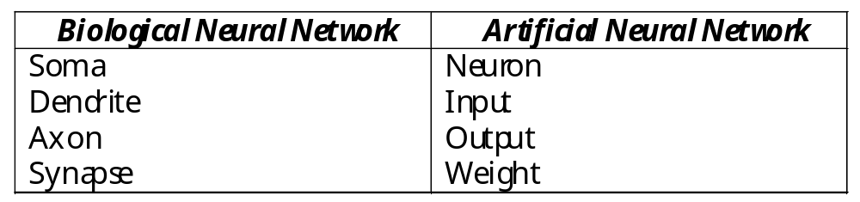
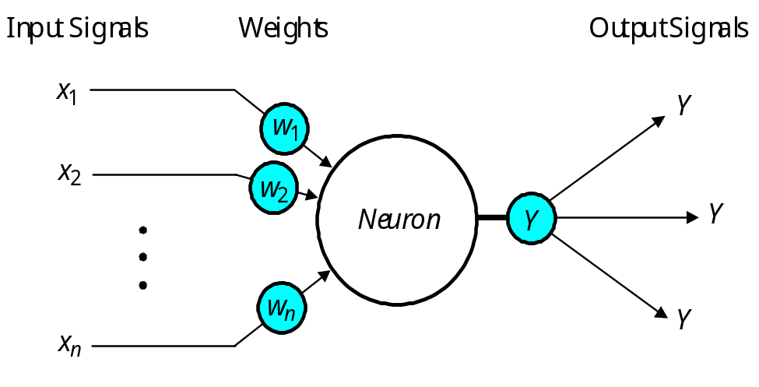
Analogy between biological and artificial neural networks
The neuron as a simple computing element

Slide 6
An artificial neuron consists of:
  Input signals: These data may come from the environment, or the activation of other neurons.
  A set of real valued weights: The weights describe connection strengths
  A threshold
  An activation function
Notes:
100亿
60万亿
突触

Slide 7
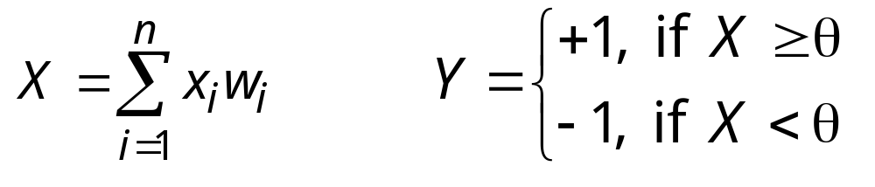
The neuron computes the weighted sum of the input signals and compares the result with a threshold value, θ. If the net input is less than the threshold, the neuron output is –1. But if the net input is greater than or equal to the threshold, the neuron becomes activated and its output attains a value +1.
The neuron can use the following transfer or activation function:
This type of activation function is called a sign function.

Slide 8
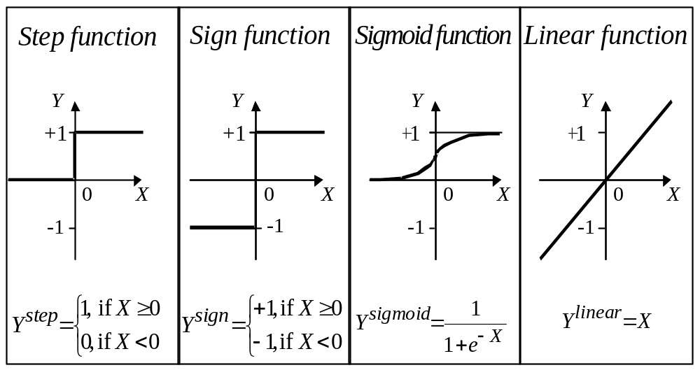
Activation functions of a neuron

Slide 9
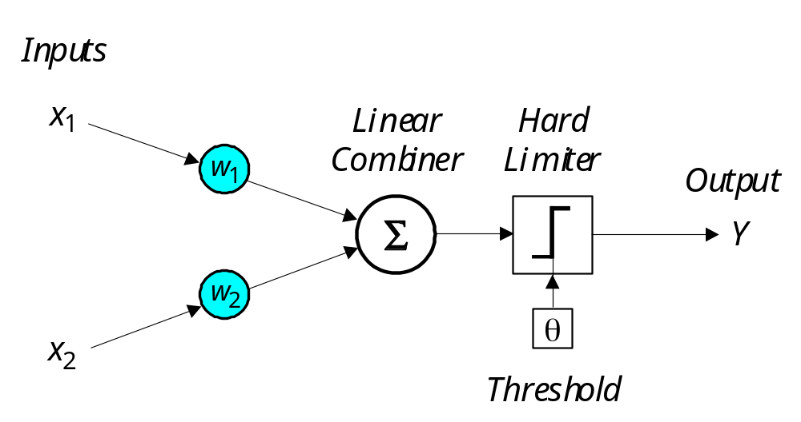
Can a single neuron learn a task?
In 1958, Frank Rosenblatt introduced a training algorithm that provided the first procedure for training a simple ANN: a perceptron.
Notes:
感知器

Slide 10
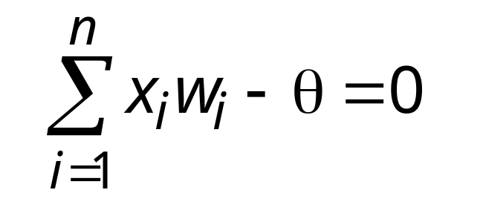
The aim of the perceptron is to classify inputs, x₁, x₂, . . ., x_{n}, into one of two classes, say A₁ and A₂.
In the case of an elementary perceptron, the n- dimensional space is divided by a hyperplane into two decision regions. The hyperplane is defined by the linearly separable function:

Slide 11
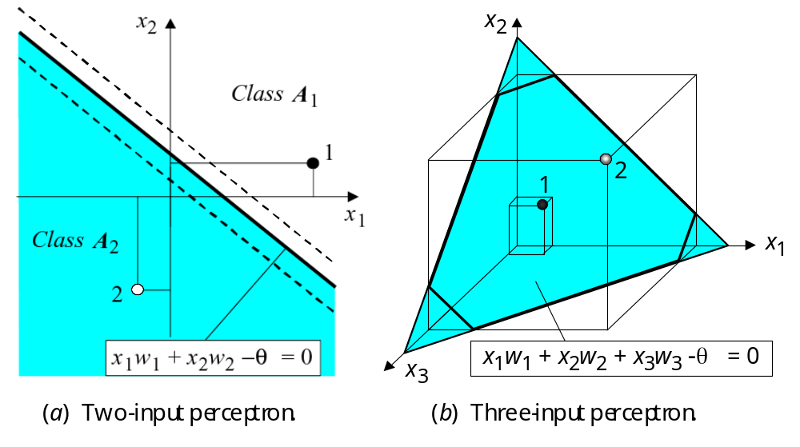
Linear separability in the perceptrons

Slide 12
How does the perceptron learn its classification tasks?
This is done by making small adjustments in the weights to reduce the difference between the actual and desired outputs of the perceptron.
The initial weights are randomly assigned, and then updated to obtain the output consistent with the training examples.

Slide 13
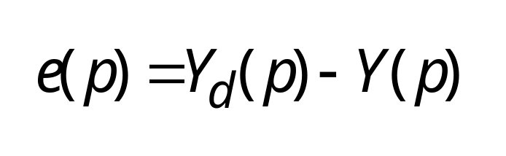
If at iteration p, the actual output is Y(p) and the desired output is Y_{d} (p), then the error is given by:
where p = 1, 2, 3, . . .
Iteration p here refers to the pth training example presented to the perceptron.
If the error, e(p), is positive, we need to increase perceptron output Y(p), but if it is negative, we need to decrease Y(p).

Slide 14
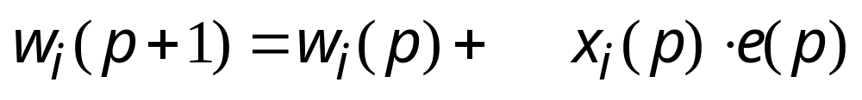
The perceptron learning rule



where p = 1, 2, 3, . . . α is the learning rate, a positive constant less than unity(1).
If the error, e(p), is positive, we need to increase perceptron output Y(p), but if it is negative, we need to decrease Y(p).

Slide 15
Perceptron’s training algorithm
Step 1: Initialisation Set initial weights w₁, w₂,…, w_{n} and threshold θ to random numbers in the range [−0.5, 0.5].
If the error, e(p), is positive, we need to increase perceptron output Y(p), but if it is negative, we need to decrease Y(p).

Slide 16
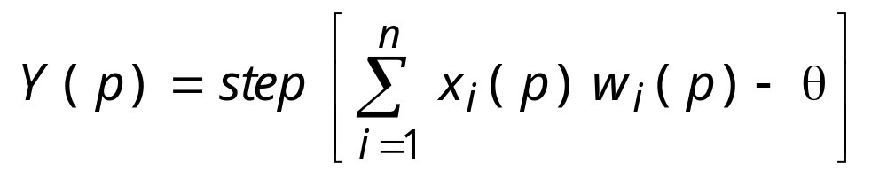
Perceptron’s training algorithm (continued)
Step 2: Activation Activate the perceptron by applying inputs x₁(p), x₂(p),…, x_{n}(p) and desired output Y_{d} (p). Calculate the actual output at iteration p = 1
where n is the number of the perceptron inputs, and step is a step activation function.

Slide 17
Perceptron’s training algorithm (continued)
Step 3: Weight training Update the weights of the perceptron
w
(
p
+
1
)
=
w
(
p
)
+
Δ
w
(
p
)
i
i
i
where Δw_{i}(p) is the weight correction at iteration p.
The weight correction is computed by the delta rule:
Δ
w
(
p
)
=
α
x
(
p
.
⋅
)
e
(
p
)
⋅
i
i
Step 4: Iteration Increase iteration p by one, go back to Step 2 and repeat the process until convergence.

Slide 18
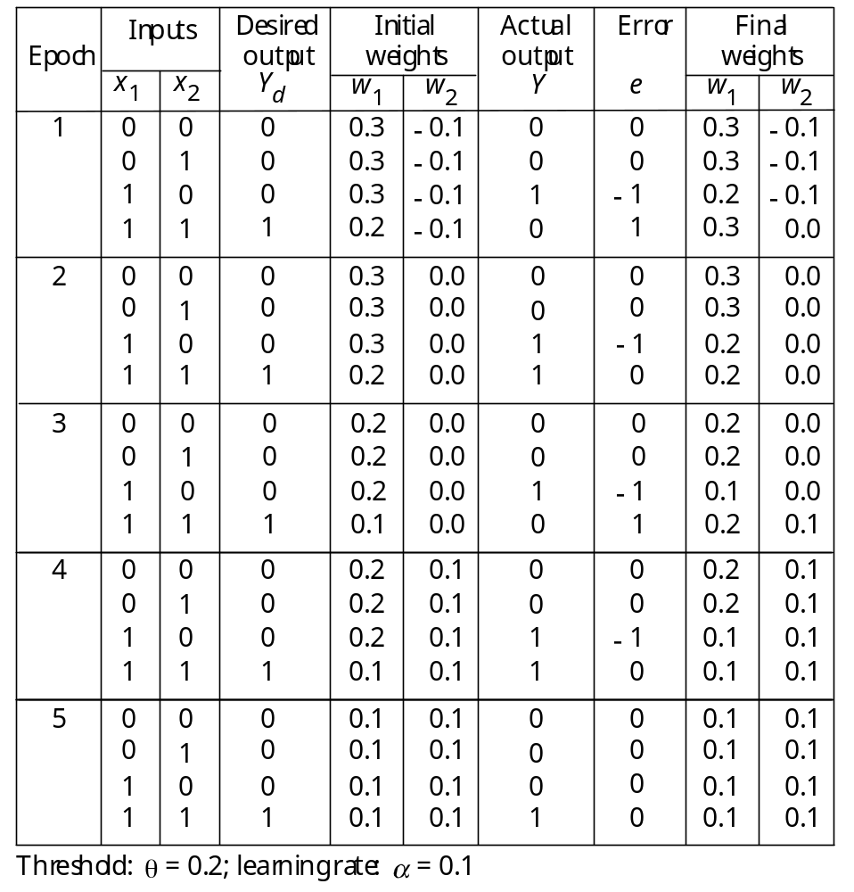
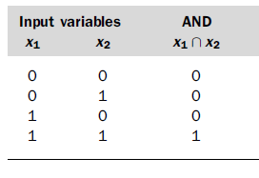
Example of perceptron learning: the logical operation AND
Training examples

Slide 19
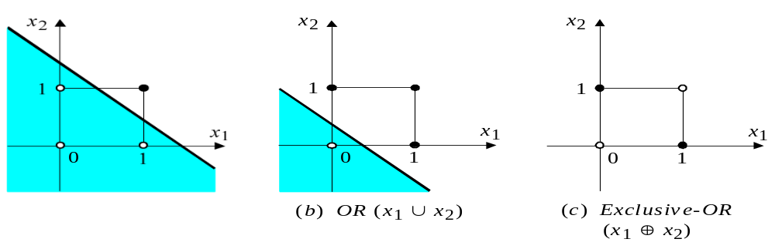
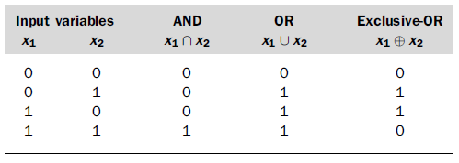
Two-dimensional plots of basic logical operations
(a) AND (x₁ ∩ x₂)
A perceptron can learn the operations AND and OR, but not Exclusive-OR.

Slide 20
Multilayer neural networks
A multilayer neural network is a feedforward neural network with one or more hidden layers.
The network consists of an input layer of source neurons, at least one middle or hidden layer of computational neurons, and an output layer of computational neurons.
The input signals are propagated in a forward direction on a layer-by-layer basis.

Slide 21
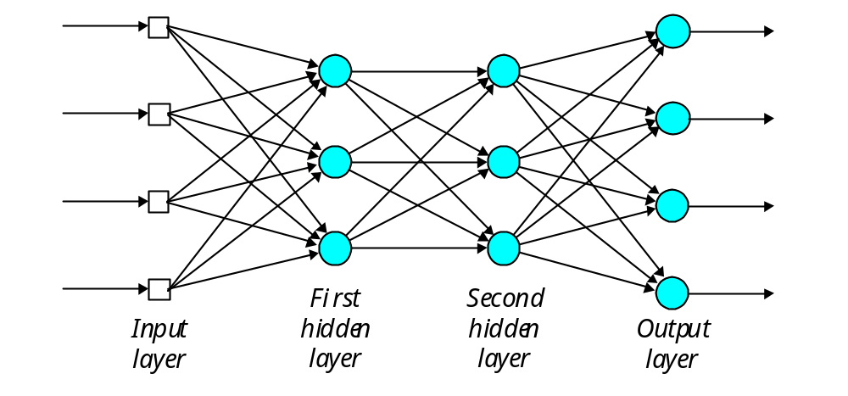
Multilayer perceptron with two hidden layers
I n p u t S i g n a l s
O u t p u t S i g n a l s
Notes:
nnd11fa

Slide 22
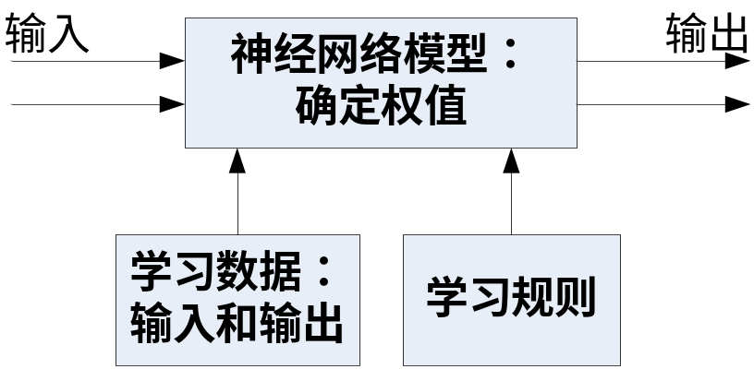
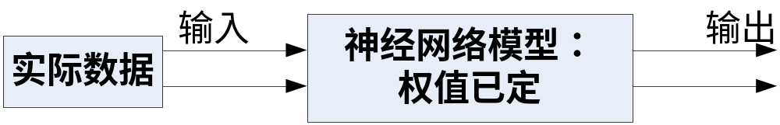
使用多层神经网络分两个阶段
先学习（训练）→再工作（识别）

Slide 23
Back-propagation neural network
Learning in a multilayer network proceeds the same way as for a perceptron.
A training set of input patterns is presented to the network.
The network computes its output pattern, and if there is an error − or in other words a difference between actual and desired output patterns − the weights are adjusted to reduce this error.

Slide 24
In a back-propagation neural network, the learning algorithm has two phases.
  First, a training input pattern is presented to the network input layer. The network propagates the input pattern from layer to layer until the output pattern is generated by the output layer.
  If this pattern is different from the desired output, an error is calculated and then propagated backwards through the network from the output layer to the input layer. The weights are modified as the error is propagated.

Slide 25
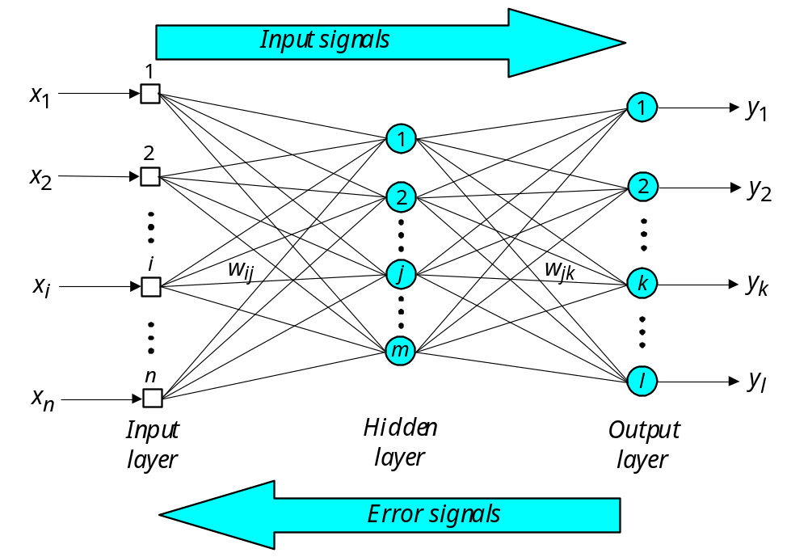
Three-layer back-propagation neural network

Slide 26
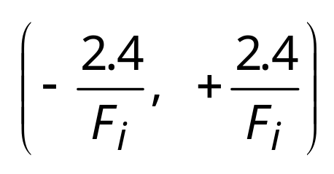
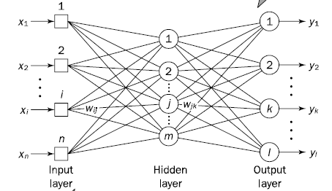
The back-propagation training algorithm
Step 1: Initialisation
Set all the weights and threshold levels of the network to random numbers uniformly distributed inside a small range:
where F_{j} is the total number of inputs of neuron j in the network. The weight initialisation is done on a neuron-by-neuron basis.

Slide 27
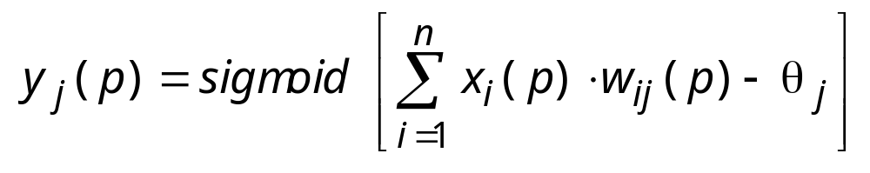
Step 2: Activation Activate the back-propagation neural network by applying inputs x₁(p), x₂(p),…, x_{n}(p) and desired outputs y_{d,1}(p), y_{d,2}(p),…, y_{d,l}(p).
(a) Calculate the actual outputs of the neurons in the hidden layer:
where n is the number of inputs of neuron j in the hidden layer, and sigmoid is the sigmoid activation function.

Slide 28
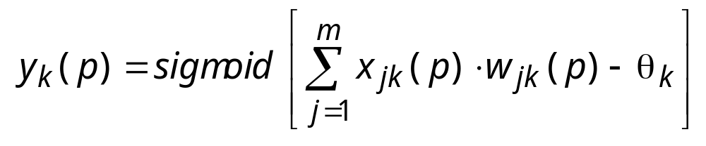
Step 2 : Activation (continued)
(b) Calculate the actual outputs of the neurons in the output layer:
where m is the number of inputs of neuron k in the output layer.

Slide 29
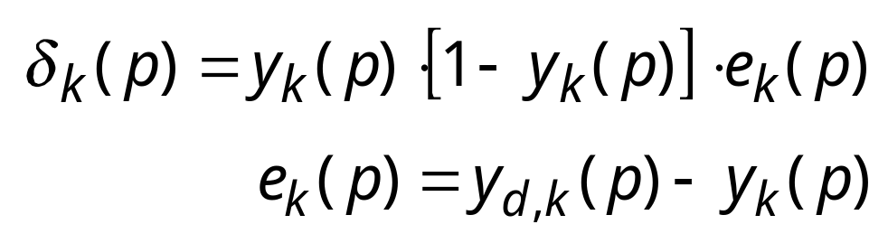
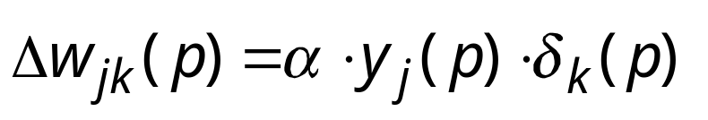
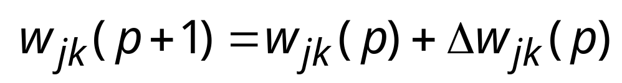
Step 3: Weight training Update the weights in the back-propagation network propagating backward the errors associated with output neurons.
(a) Calculate the error gradient for the neurons in the output layer:
where
Calculate the weight corrections:
Update the weights at the output neurons:

Slide 30
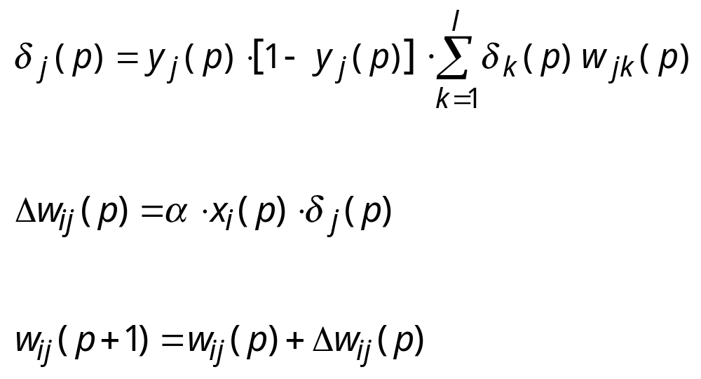
Step 3: Weight training (continued)
(b) Calculate the error gradient for the neurons in the hidden layer:
Calculate the weight corrections:
Update the weights at the hidden neurons:

Slide 31
Step 4: Iteration Increase iteration p by one, go back to Step 2 and repeat the process until the selected error criterion is satisfied.

Slide 32
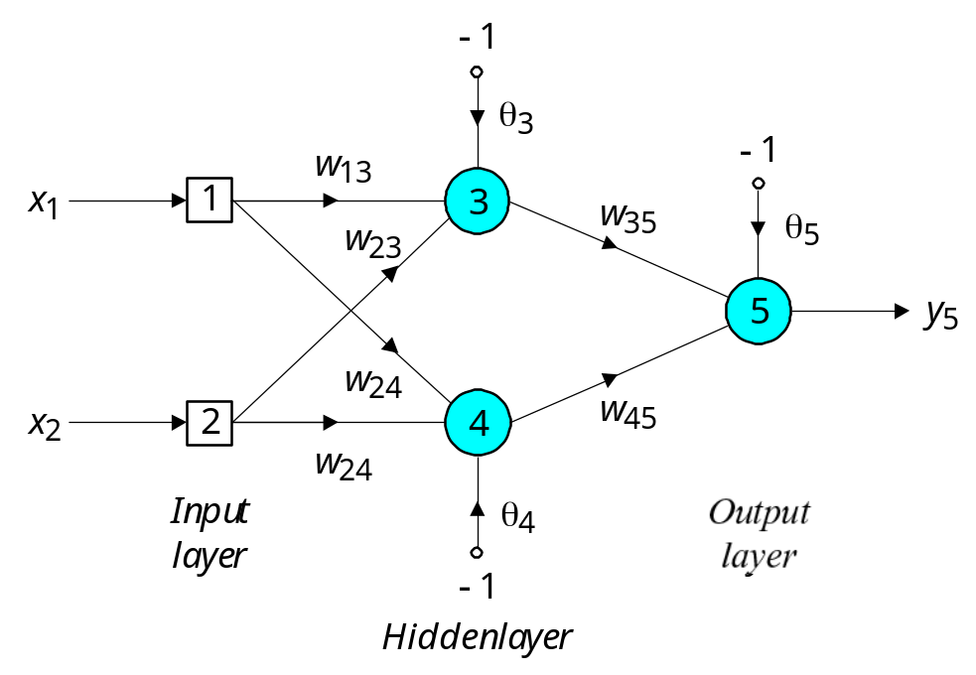
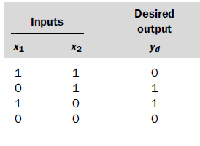
An example
As an example, we may consider the three-layer back-propagation network. Suppose that the network is required to perform logical operation Exclusive-OR. Recall that a single-layer perceptron could not do this operation.
Three-layer network for solving the Exclusive-OR operation

Slide 33
The effect of the threshold applied to a neuron in the hidden or output layer is represented by its weight, θ, connected to a fixed input equal to −1.
The initial weights and threshold levels are set randomly as follows: w₁₃ = 0.5, w₁₄ = 0.9, w₂₃ = 0.4, w₂₄ = 1.0, w₃₅ = −1.2, w₄₅ = 1.1, θ₃ = 0.8, θ₄ = −0.1 and θ₅ = 0.3.

Slide 34
We consider a training set where inputs x₁ and x₂ are equal to 1 and desired output y_{d,5} is 0. The actual outputs of neurons 3 and 4 in the hidden layer are calculated as
−
(
1
⋅
0
.
5
+
1
⋅
−
⋅
y
=
si
gm
oi
d
(
x
w
+
x
w
−
θ
)
=
1
/
1
+
e
0
.
4
1
0
.
8
)
=
0
.
5250
3
1
13
2
23
3
−
(
1
⋅
+
⋅
+
⋅
y
=
si
gm
oi
d
(
x
w
+
x
w
−
θ
)
=
1
/
1
+
e
0
.
9
1
1
.
0
1
0
.
1
)
=
0
.
8808
4
1
14
2
24
4
Now the actual output of neuron 5 in the output layer is determined as:
−
(
−
0
.
⋅
+
⋅
−
⋅
y
=
si
gm
oi
d
(
y
w
+
y
w
−
θ
)
=
1
/
1
+
e
5250
1
.
2
0
.
8808
1
.
1
1
0
.
3
)
=
0
.
5097
5
3
35
4
45
5
Thus, the following error is obtained:
e
=
y
−
y
=
0
−
0
.
5097
=
−
0
.
5097
d
,
5
5
w₁₃ = 0.5, w₁₄ = 0.9, w₂₃ = 0.4,
w₂₄ = 1.0, w₃₅ = −1.2, w₄₅ = 1.1,
θ₃ = 0.8, θ₄ = −0.1 and θ₅ = 0.3.

Slide 35
The next step is weight training. To update the weights and threshold levels in our network, we propagate the error, e, from the output layer backward to the input layer.
First, we calculate the error gradient for neuron 5 in the output layer:
=
y
(
1
−
y
)
e
=
0.
5097
⋅
−
⋅
−
=
−
5
5
5
(1
0.
5097)
(
0
.
5097)
0
.
1274
Then we determine the weight corrections assuming that the learning rate parameter, α, is equal to 0.1:
Δ
w
=
⋅
y
⋅
=
0
.
1
⋅
⋅
−
=
−
35
3
5
0
.
5250
(
0
.
1274
)
0
.
0067
Δ
w
=
⋅
y
⋅
=
0
.
1
⋅
⋅
−
=
−
45
4
5
0
.
8808
(
0
.
1274
)
0
.
0112
Δ
θ
=
⋅
−
⋅
=
⋅
−
⋅
−
=
−
5
(
1
)
5
0
.
1
(
1
)
(
0
.
1274
)
0
.
0127

Slide 36
Next we calculate the error gradients for neurons 3 and 4 in the hidden layer:
=
y
(
1
−
y
)
⋅
⋅
=
⋅
−
⋅
−
⋅
−
=
3
3
3
5
w
35
0.
5250
(1
0.
5250)
(
0.
1274)
(
1
.
2
)
0
.
0381
=
y
(
1
−
y
)
⋅
⋅
=
⋅
−
⋅
−
⋅
=
−
4
4
4
5
w
45
0.
8808
(1
0.
8808)
(
0.
127
4)
1
.1
0.
0147
We then determine the weight corrections:
Δ
w
=
⋅
x
⋅
=
0
.
1
⋅
1
⋅
0
.
0381
=
0
.
0038
13
1
3
Δ
w
=
⋅
⋅
=
⋅
⋅
=
23
x
2
3
0
.
1
1
0
.
0381
0
.
0038
Δ
θ
=
⋅
−
⋅
=
⋅
−
⋅
=
−
3
(
1
)
3
0
.
1
(
1
)
0
.
0381
0
.
0038
Δ
w
=
⋅
⋅
=
⋅
⋅
−
=
−
14
x
1
4
0
.
1
1
(
0
.
0147
)
0
.
0015
Δ
w
=
⋅
⋅
=
⋅
⋅
−
=
−
24
x
2
4
0
.
1
1
(
0
.
0147
)
0
.
0015
Δ
θ
=
⋅
−
⋅
=
⋅
−
⋅
−
=
4
(
1
)
4
0
.
1
(
1
)
(
0
.
0147
)
0
.
0015

Slide 37
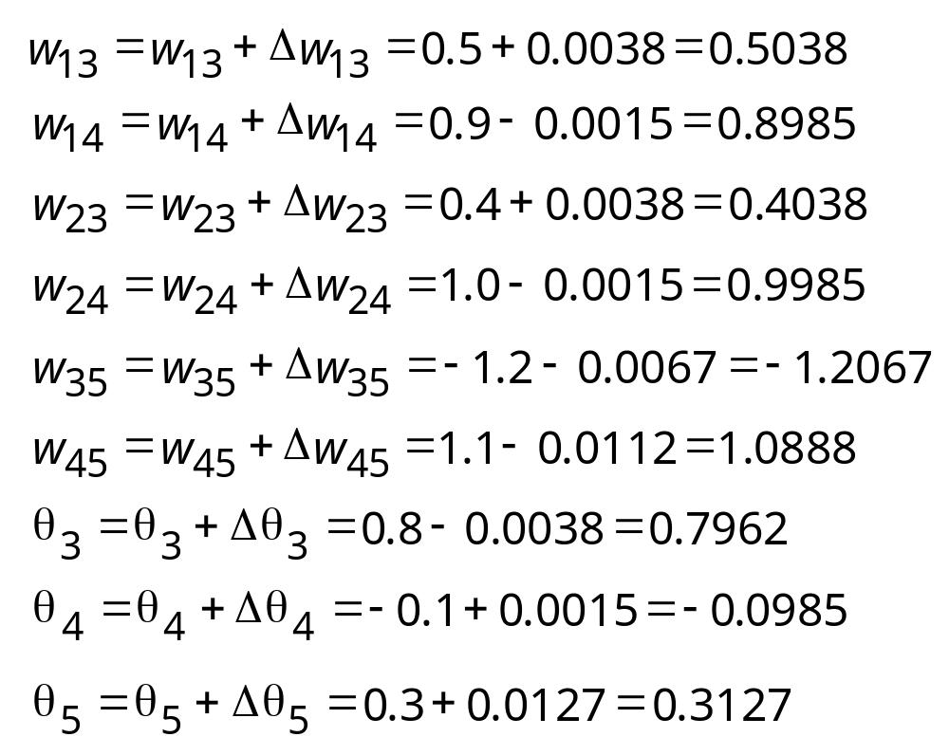
At last, we update all weights and threshold:
The training process is repeated until the sum of squared errors is less than 0.001.

Slide 38
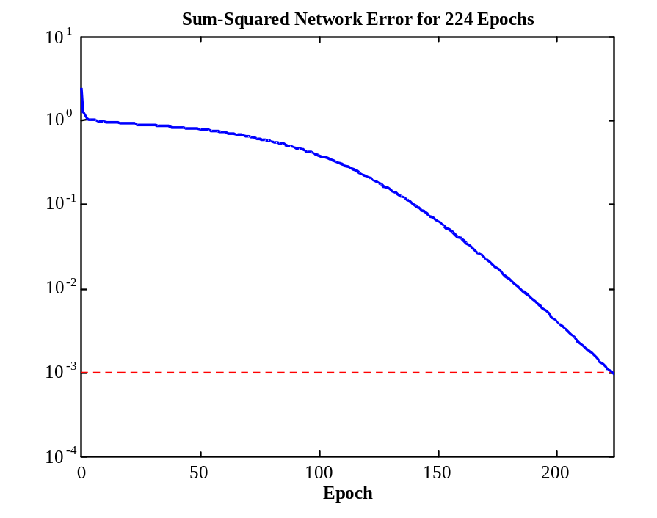
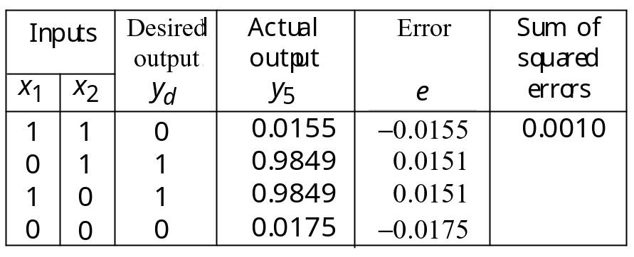
Learning curve for
operation Exclusive-OR
Final results of three-layer
network learning
Sum-Squared Error
Notes:
44

Slide 39
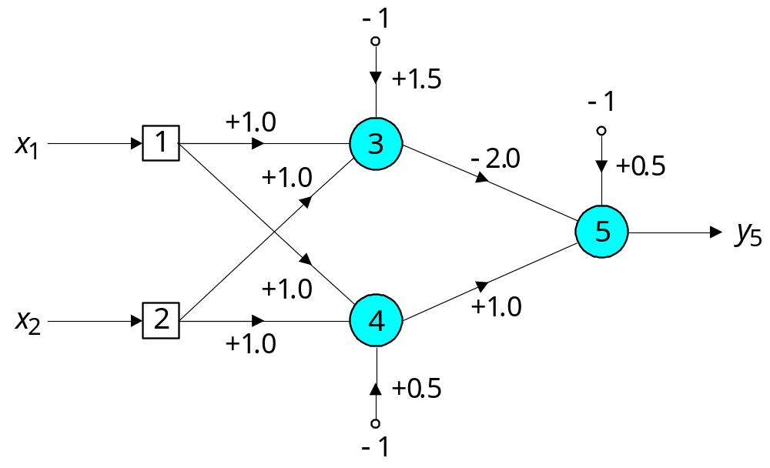
Network using step function for solving the Exclusive-OR operation

Slide 40
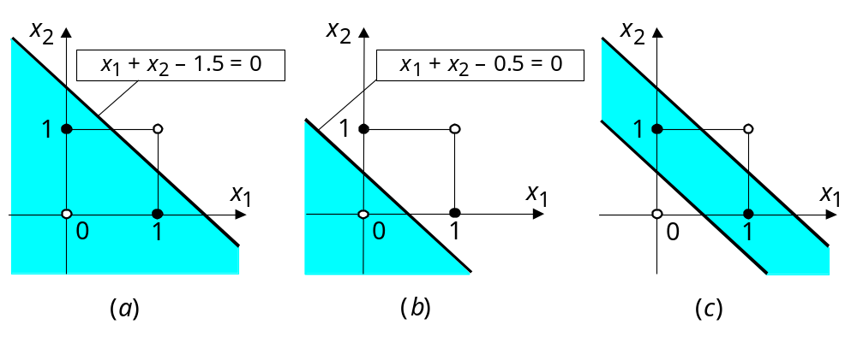
Decision boundaries
Decision boundary constructed by hidden neuron 3; (b) Decision boundary constructed by hidden neuron 4; (c) Decision boundaries constructed by the complete three-layer network

